Slide 1

Inventory Management System for Anemos Energies
Prepared By:
Abdullah Shaikh 191106001
Aslan Shaikh 191106009
Joseph Roy Thayil 191106023

Slide 2
Agenda
Introduction about company.
Overview of Inventory Management System.
Problem statement.
Purpose of the project.
Research papers.
Proposed solutions.
Algorithms
Conclusion.

Slide 3

INTRODUCTION ABOUT COMPANY
Anemos Energies Pvt Ltd (AEPL) founded in 2016.
Strong wind energy fundamentals, sophisticated technology, precise manufacturing, and stringent quality controls
Delivers powerful and aggressively priced wind energy solution
Global team with European and Asian members.
Research team in China for over a decade for cost-effective testing
Diverse team provides edge in delivering high-tech wind turbine at affordable price point
Goal: make clean renewable energy universally accessible.

Slide 4
Problem statement
Problem Statement: The manual process of managing inventory is becoming increasingly difficult and inefficient in today's fast-paced business environment. This leads to a number of challenges, including:
Inaccurate tracking of inventory levels
Increased costs due to overstocking or stock shortages
Poor customer satisfaction due to unavailability of products
Time-consuming manual processes
Inability to make informed decisions about inventory levels and reordering
Lack of real-time data on stock levels and demand patterns
These challenges highlight the need for a more efficient and automated solution for inventory management.

Slide 5
Introduction
Inventory Management System developed using Flutter and Android Studio
Uses Nodejs and Expressjs for backend
Objective: comprehensive overview of organization's stock
Intranet-based, with admin component to manage inventory
Includes organization profile, sales, purchase, and stock details
Real-time information on stock balance and transactions
Stock updated based on transactions or returned sales.
Login page for secure management of stock.
Designed for Anemos Energies Goa with actors: admin, operator, vendor
Each actor with specific rights and access levels.

Slide 6
Research papper
Title: Predictive Models for Wind Speed.
Author: Md Aminul Ehsan.
Date: December 2019
Research Objective: Prediction of wind speed for a given time using meteorological parameters.
To address the objective, twelve artificial intelligence algorithms were used for wind speed prediction

Slide 7
Predictive Models for Wind Speed.
Algortithms used:
Multiple Linear Regression
Ridge Regression
Lasso Regression
Bayesian Ridge Regression
Huber Regression
Bagging Regression
Random Forest Regression
AdaBoost Regression
SVR
DNN
CNN
RNN - LSTM

Slide 8
Dataset
Three-months-long period starting from May 1, 2018 to July 31, 2018
Average hourly instances
Retrieved from National Renewable Energy Laboratory (NREL) database
18 features, including wind speed in 80m height as response variable.
Best Performance: LSTM (Model-12)
Lowest error terms
Exact accuracy of 97.8%
Result: LSTM Outperforms Other Models, Highest accuracy of 97.8%.

Slide 9
Research paper - 2
Title: A Review of QR code Structure for Encryption and Decryption Process
Author: Divya Sharma
Publishers: International Journal of Innovative Science and Research Technology
ISSN No: - 2456- 2165
QR Code is a matrix or a 2-dimensional barcode based symbol with a cell structure which is formatted in a square.
It can store up to 4296 alphanumeric characters and can be read by optical device with the appropriate software like QR code reader and mobile phones.

Slide 10
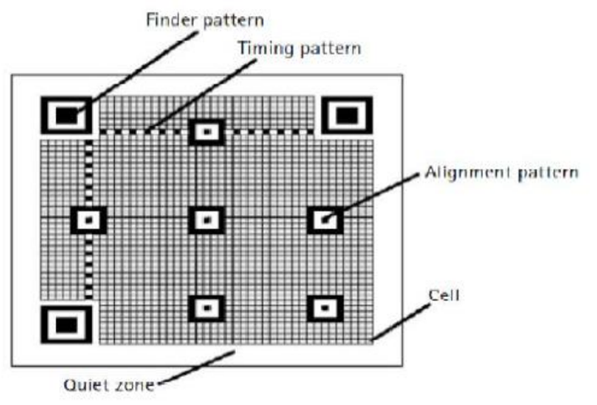
QR CODE STRUCTURE
1. Finder Pattern:
Separated from the rest of the QR Code by light area
Three identical structures in all corners except bottom right
Enables decoder software to recognize and determine orientation.
2. Alignment Pattern:
Determines perspective distortion
Supports decoder software correction
Added with growing QR Code size.
3. Timing Pattern:
Alternating black/white modules
Determines module width
Interconnects finder patterns
Determines size, rows/columns, distortion

Slide 11
QR CODE STRUCTURE
4. Quiet Zone:
Blank margin on barcode sides
Tells scanner symbol start/stop
Prevents scanner from extraneous info
White area of width 4 modules
No confusing patterns or structures
5. Data Area:
Bit stream converted, stored as code words
Encoded, protected by error correction
Reed-Solomon algorithm restores damaged data
Four levels of error correction (L, M, Q, H)
Error correction reduces QR Code data capacity.

Slide 12
Research paper - 3

Slide 13
Modules
Admin Module
Operator Module.
QR Code System Module
Forecasting Module
Reports Module
User Management Module.
Image classification

Slide 14
Login module
Purpose: The Login Module is responsible for authenticating and authorizing the actors in the system.
Access Control: The module implements access control to ensure only authorized actors can access the system's features.
User Authentication: The module handles user authentication, verifying the user's identity before allowing access to the system.
Actor Management: The module manages the different actors in the system, including the admin, operator, and vendor, and assigns specific rights and access levels.
Secure Login: The module implements a secure login process to protect the organization's stock and prevent unauthorized access.
User Session Management: The module handles the management of user sessions, including the creation and termination of sessions as needed.

Slide 15
Admin module
Purpose: The Admin Module is responsible for managing and controlling the inventory within the organization.
Inventory Management: The module manages the overall inventory, including adding, updating, and deleting inventory items.
Stock Overview: The module provides a comprehensive overview of the organization's stock, including real-time information on the remaining balance of stock and transaction details.
User Activity Tracking: The module tracks the activities of the operator, including all operations that modify the database records, for auditing purposes.
Reporting: The module provides reporting on the sales, purchases, and remaining inventory, including the auditing system for transparency.
User Management: The module manages the actors in the system, including assigning rights and access levels.
Vendor Management.

Slide 16
QR CODE:
QR code system for quick retrieval of item information
QR code generated after operator adds item details
QR code can be printed and attached to box
Scanning QR code displays item details in system
Allows operator to make modifications as needed
QR code generation
Store Item details
QR code scanning
Get item details
QR code can be printed and attached to box.
Advantages:
Efficient method to store item details
Get item details quickly
Secure

Slide 17
Algorithm for generating qr code.
Generating QR code:
Start the application and navigate to the QR code generation screen.
Enter the item details such as name, quantity, and date into the form.
The application will generate a QR code based on the entered information.
The QR code is displayed on the screen and can be saved or printed.
The QR code is attached to the item's box or packaging.
The QR code can be scanned later to retrieve the item details for updating or viewing.

Slide 18
Algorithm for scanning qr code
Scanning QR code:
Start the application and navigate to the QR code scanning screen.
Point the device camera at the QR code.
The application will detect the QR code and capture its image.
The image is processed to extract the data encoded in the QR code.
The extracted data is compared against the database to retrieve information about the item.
If a match is found, the item details are displayed on the screen for the operator to view.
The operator can modify the details as required and update the database.

Slide 19
BLOCK DIAGRAM FOR QR CODE SCANNING
No
Send error message
Found QR Code?
Capture Image
Process Image
Process the QR code
Image
Yes
Display Item Details
Format the data
Get output text

Slide 20
Image classification
Identifying items directly using its image.
Quick fetching and updation.
Image classification will be done on client side (phone).
Advantages:
Reduction in operational time
Consistent item names in database
No need to type
No need to remember exact item names
Helpful for illiterate workers.

Slide 21
Algorithm
General algo.
Input: Image of an item
Pre-processing:
a. Resize image
b. Convert to grayscale/RGB
c. Normalize image
Feature Extraction:
a. Extract features using filters
b. Represent as feature vector
Model Selection:
a. Train ML model using labeled dataset
b. Select best model based on accuracy, speed, etc.
Model Prediction:
a. Classify input image
b. Get class label & confidence score
Database Lookup:
a. Retrieve item details based on predicted class label
b. Store details in dictionary/object
Output: Item details (name, description, quantity, price, etc.).

Slide 22
BLOCK DIAGRAM FOR IMAGE CLASSIFICATION
Capture Image
Process Image
Send Image to ML Model
Get Item ID
Image
Display Item Details
Fetch Data from database using Item ID

Slide 23
Wind power forecasting
Intelligent technique for forecasting wind speed, power output
Forecast for next whole month, daily basis
Utilize publicly available weather, energy data sets
Consider various features (temp, wind direction, atmospheric pressure)
Improve accuracy of forecasts.
Wind speed prediction using LSTM algorithm.
ADVANTAGES:
Help customers plan power usage, make informed decisions
Better energy planning and usage
Informed decision making for wind turbine installation
Improved accuracy of wind speed, power output forecasts
Helps with reducing uncertainty in wind energy generation
Better management of wind energy resources
Increased efficiency and effectiveness of wind energy utilization.

Slide 24
Algorithm
Generating forecasting model:
Load public data sets
Pre-process data
Select relevant features
Use RNN-LSTM
Train & validate model
Evaluate performance
Repeat steps 4-6 if needed
Use model for forecasting
Store forecasted values in database.

Slide 25
Working
User need to share his location.
Prediction of future Wind speed.
Based on that, power output will be calculated.
beneficial or not?
Relationship of wind speed with turbine power:
2 types of turbine
Wind speed | Large Turbine | Small Turbine
5 m/s | 2 kw/hr | 1 kw/hr
10 m/s | 4.5 kw/hr | 2 kw/hr

Slide 26
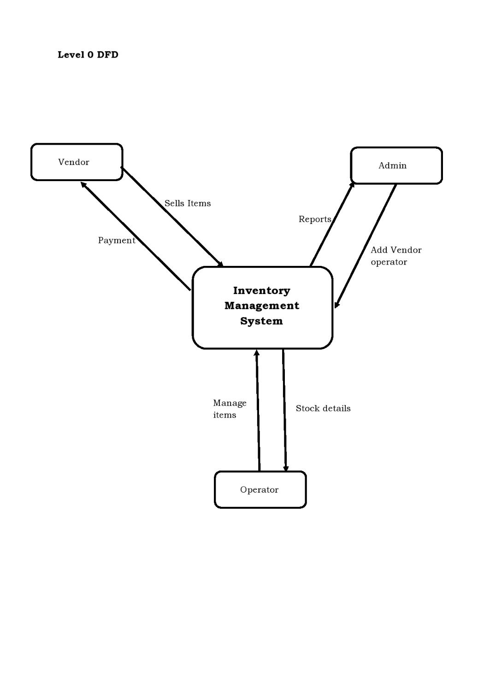
Dataflow diagrams.
Level 0 DFD.
Entites :
Vendor
Admin
Operator.

Slide 27
Level 1 DFD

Slide 28
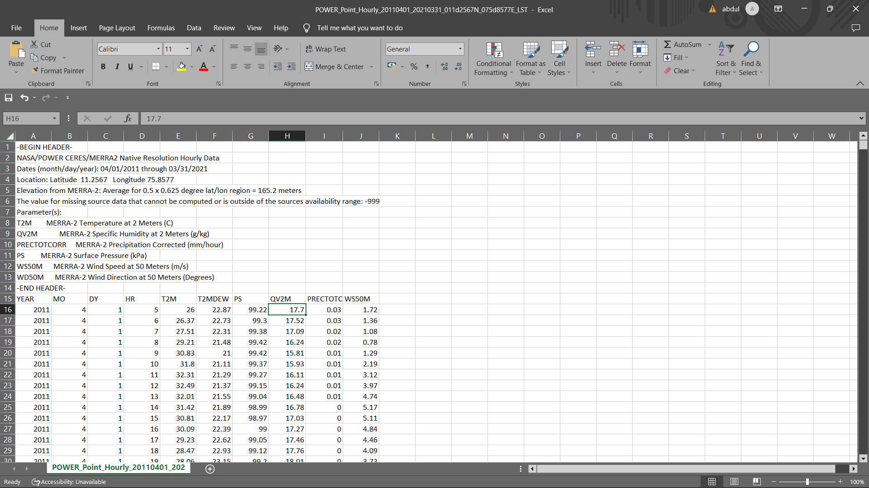
Datasets
Work done on datasets.
Dataset taken from -https://power.larc.nasa.gov/data-access-viewer/ website
Provides windspeed, temperature.

Slide 29
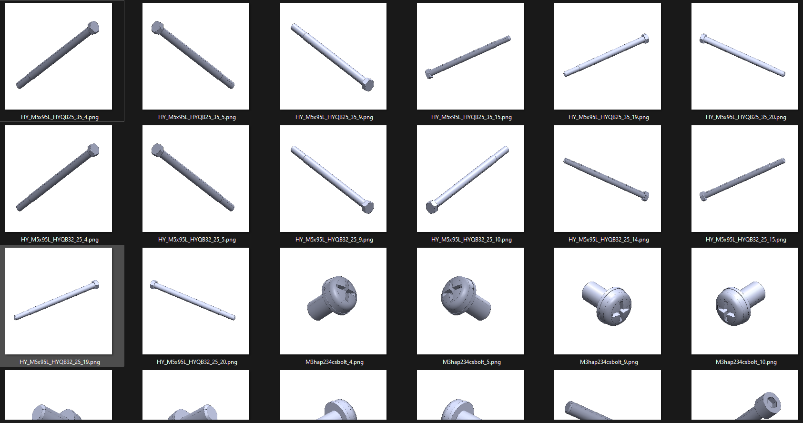
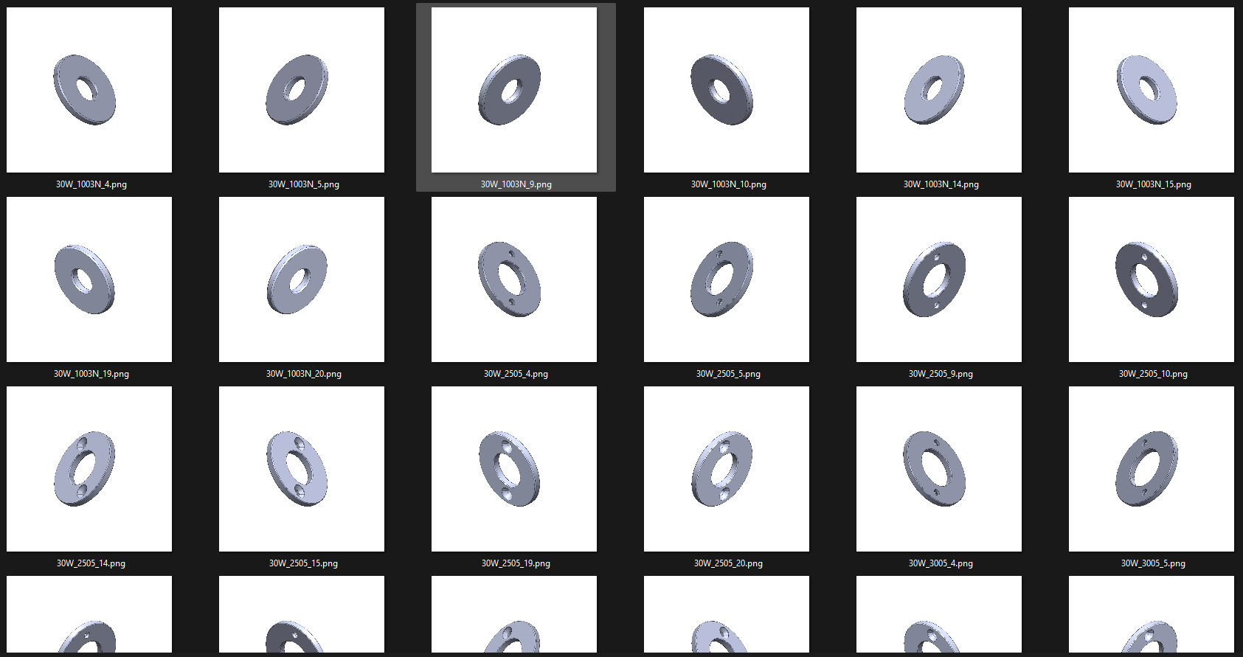
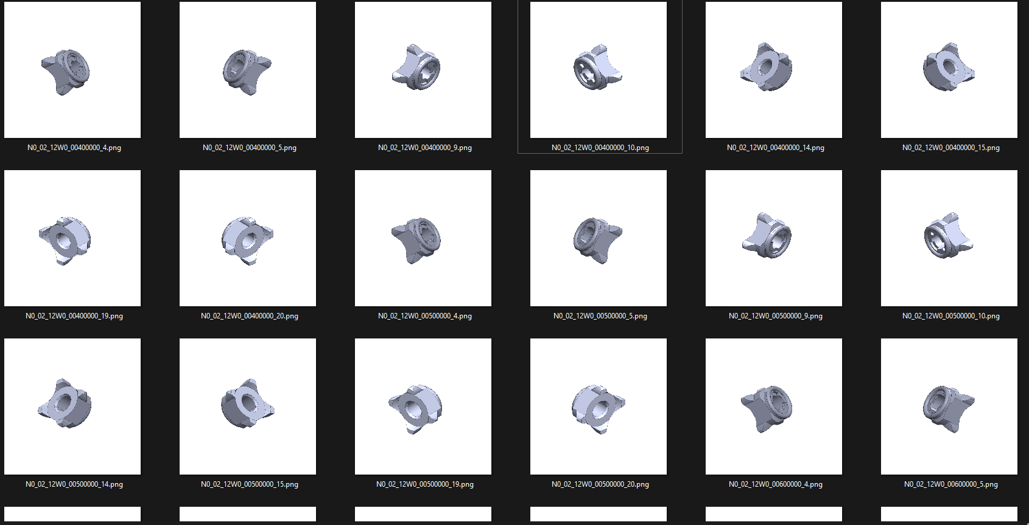
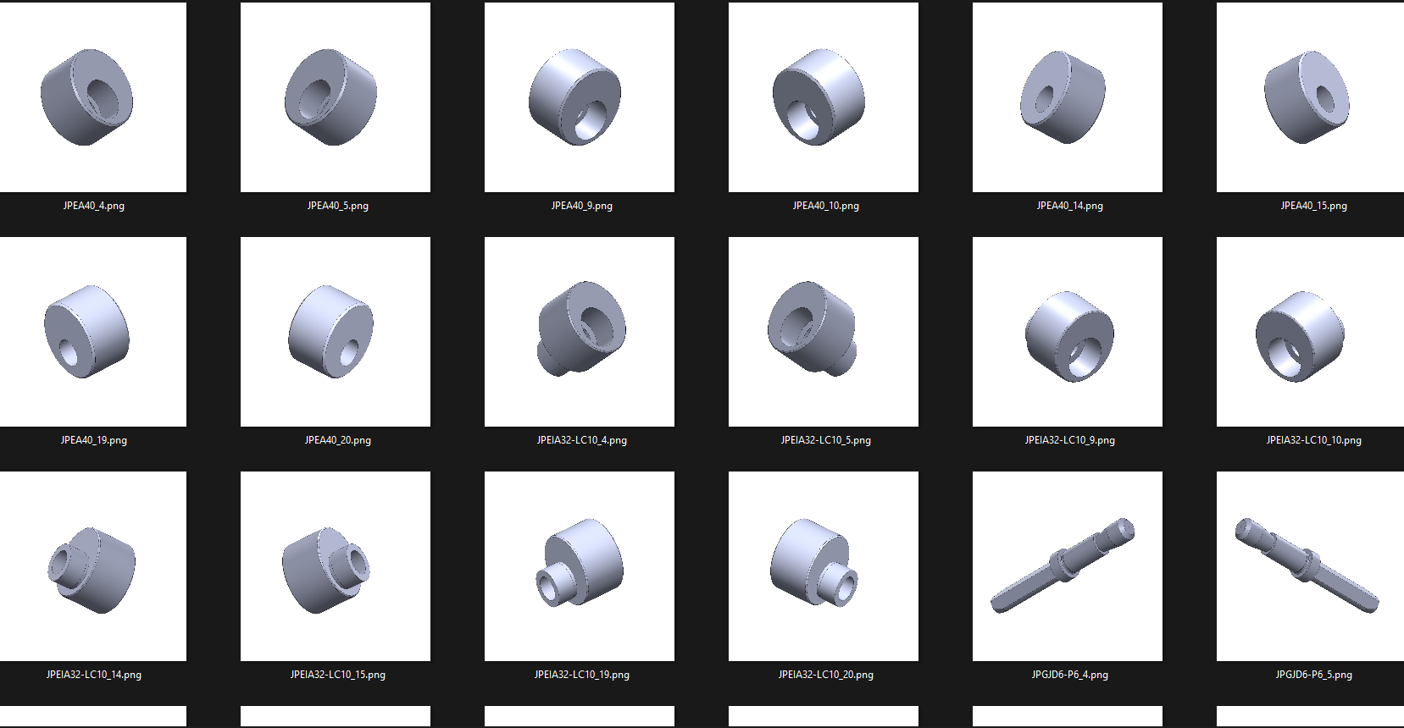
Datasets
Sources:
DATASET - Images of mechanical parts (Bolt, Nut, Washer, Pin) https://www.kaggle.com/datasets/manikantanrnair/images-of-mechanical-parts-boltnut-washerpin
Bolts
Washer
Nuts
Locating Pin

Slide 30
Software & hardware requirements.
Software:
Windows:
Microsoft® Windows® 7/8/10 (64-bit)
Android studio.
Visual studio code.
Xammp.

Slide 31
Hardware Requirements:
4 GB RAM minimum, 8 GB RAM recommended
2 GB of available disk space minimum,
4 GB Recommended (500 MB for IDE + 1.5 GB for Android SDK and emulator system image)
1280 x 800 minimum screen resolution

Slide 32
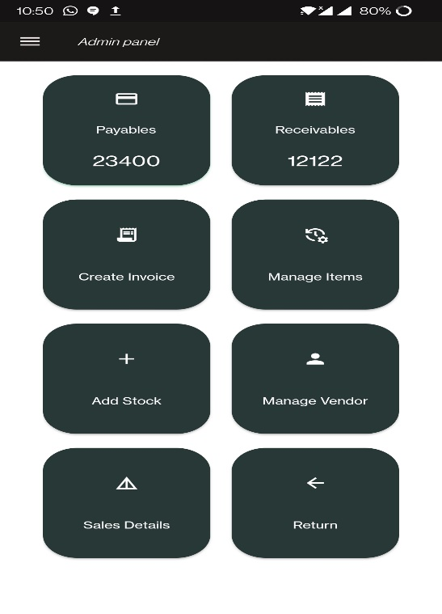
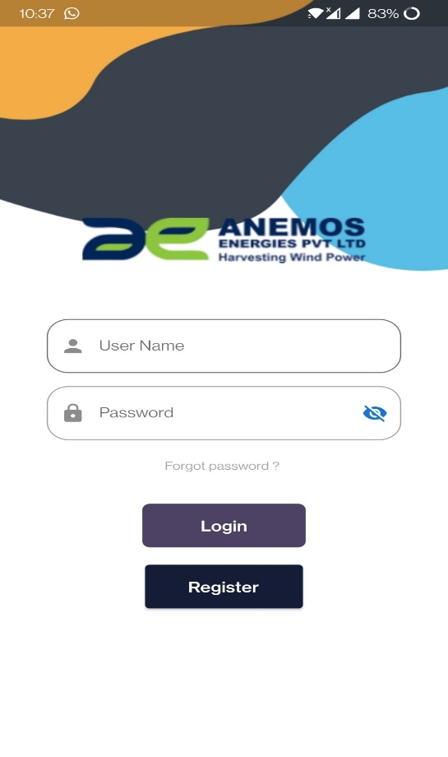
Implementation
Designed UI of app
Admin console: 2. Login screen:

Slide 33
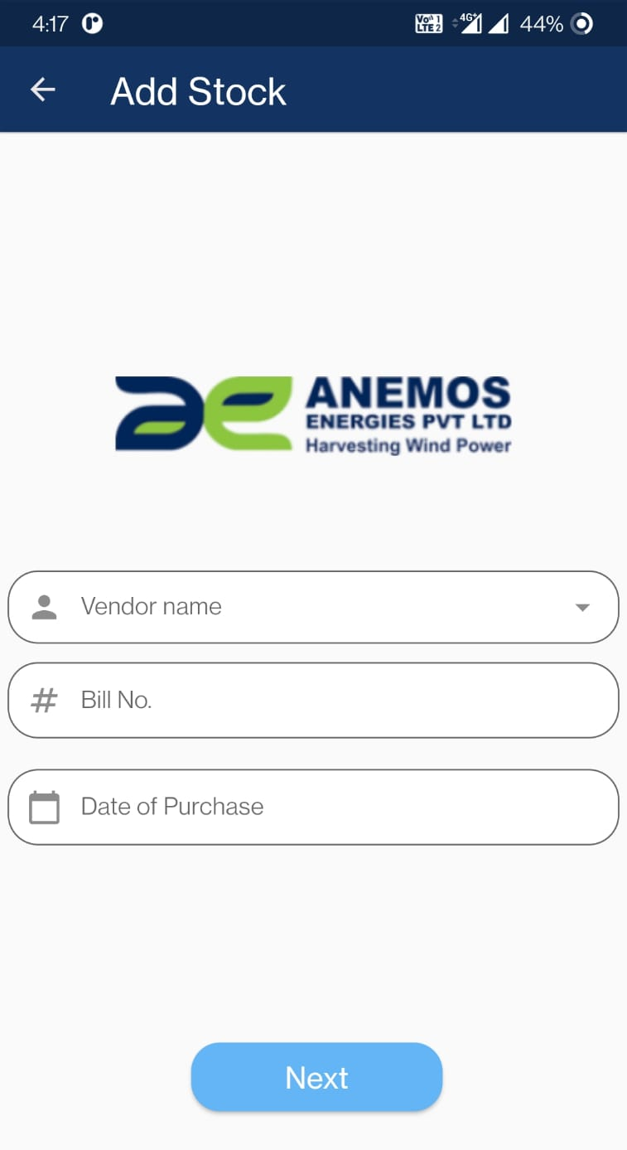
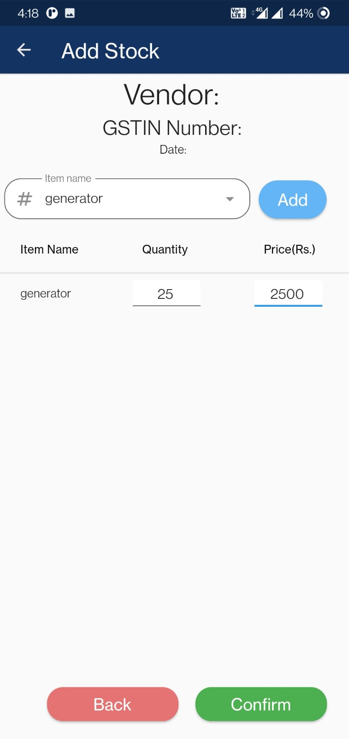
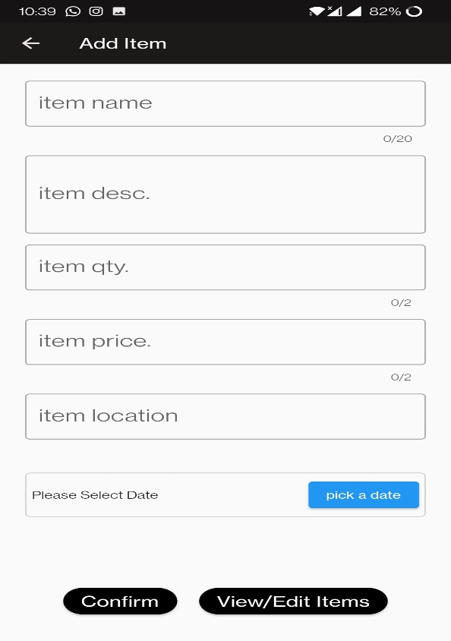
Add stock screen: Add item screen

Slide 34
Login with session tokens.

Slide 35

Research Papers
A Review of QR code Structure for Encryption
and Decryption Process
International Journal of Innovative Science and Research Technology ISSN No: - 2456- 2165
Key-points:
2-dimensional barcode.
4296 alphanumeric characters.
Read by optical device with the appropriate software
Example: QR code reader, mobile phones.
Link: - https://ijisrt.com/wp-content/uploads/2017/03/A-Review-of-QR-code-Structure-for-Encryption-and-Decryption-Process.pdf

Slide 36

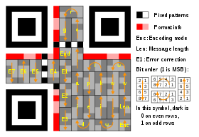

Feasibility study
QR code generation and scanning API:
https://developers.google.com/chart/infographics/docs/qr_codes
Deprecated
https://goqr.me/api/
API call
https://api.qrserver.com/v1/create-qr-code/?size=150x150&data={nuts: 400; bolts: 300; washers: 400; generator: 20 }
QR code structure

Slide 37
A SURVEY ON IMAGE CLASSIFICATION APPLICATION TECHNIQUES
Kamavisdar, Saluja & Agrawal (2013)
PURPOSE:
Multiple dataset that being located under each of Hierarchical classifier.
Rejection of the class on the intermediary stage.
METHOD USED:
Decision Tree
RESULT:
Considered very simple and high rate of efficiency.
Link:-
https://www.researchgate.net/publication/269984702_A_survey_of_image_classification_methods_and_techniques

Slide 38
FAST IMAGE CLASSIFICATION BY BOOSTING FUZZY CLASSIFIERS
Korytkowski, Rutkowski & Scherer (2016)
PURPOSE:
Simple boosting Meta knowledge where local characteristic can be mostly formed.
METHOD USED:
Fuzzy Classifiers
RESULT:
Learning and classification is very fast although accuracy is not up to the mark.
Link:-
https://www.researchgate.net/publication/282175413_Fast_Image_Classification_
by_Boosting_Fuzzy_Classifiers

Slide 39

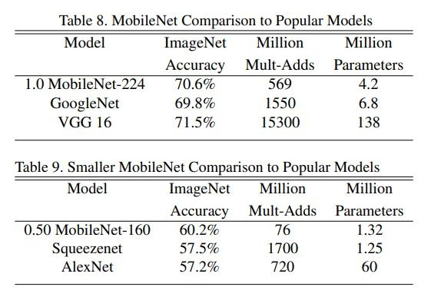

MobileNets: Efficient Convolutional Neural Networks for Mobile Vision Applications Google Inc.
It is more accurate than GoogleNet while being smaller and more than 2.5 times less computation.
MobileNet is nearly as accurate as VGG16 while being 32 times smaller and 27 times less compute intensive.
Table 9 compares a reduced MobileNet with reduced resolution 160 × 160.
ReducedMobileNet is 4% better than AlexNet while being 45×smaller and 9.4× less compute than AlexNet.
It is also 4%better than Squeezenet at about the same size and 22×less computation.

Slide 40
Convolutional Neural Network (CNN)
Advantages:
CNNs do not require human supervision for the task of identifying important features.
They are very accurate at image recognition and classification.
Weight sharing is another major advantage of CNNs.
Convolutional neural networks also minimize computation in comparison with a regular neural network.
CNNs make use of the same knowledge across all image locations

Slide 41
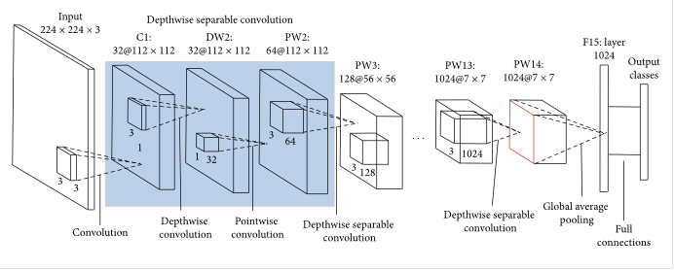
Mobilenet
MobileNet uses a Convolutional Neural Network (CNN) architecture model.
lightweight making it more suitable for embedded systems and mobile devices.
MobileNetV2 significantly reduces the number of parameters thus making it less complex.
Architecture of MobileNetV2 model:

Slide 42
Feasibility study:
Tensorflow lite models in flutter
deprecated
Google ml kit module in flutter
Custom model
Classifies more than 400+ objects.
Hence larger in size.

Slide 43
Work done from pr-1 to pr-2
Decided the source of dataset.
Feasibility study of existing algorithms
WEEK 3
WEEK 1
WEEK 2
Referred research papers on image classification
Literature survey for QR code.

Slide 44
POWER PREDICTION

Slide 45
Thank you

